Slide 1
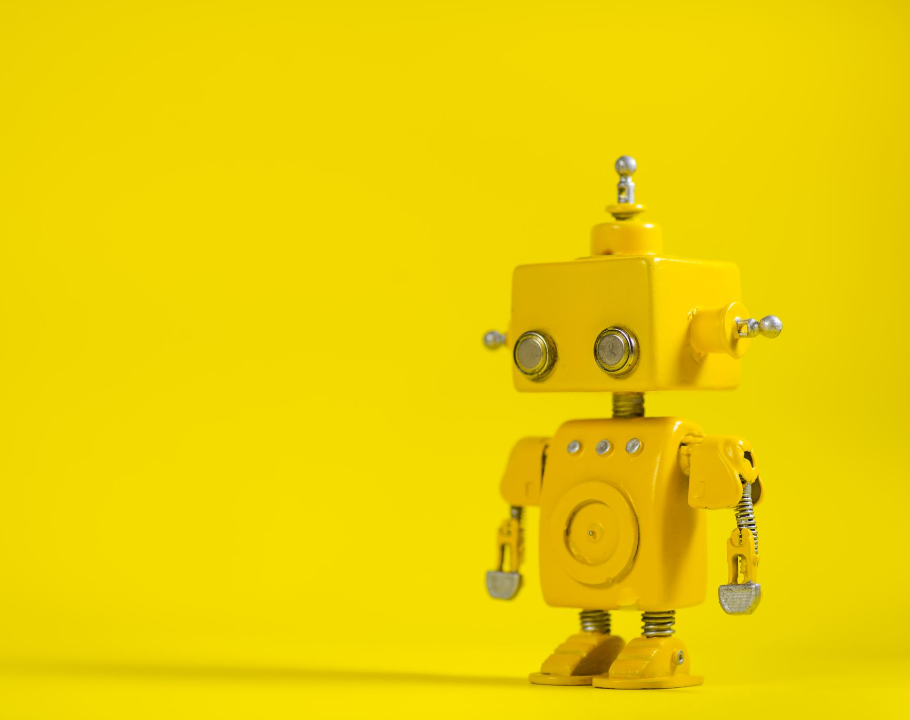
Different attitudes toward robots across cultures
By brian kim

Slide 2
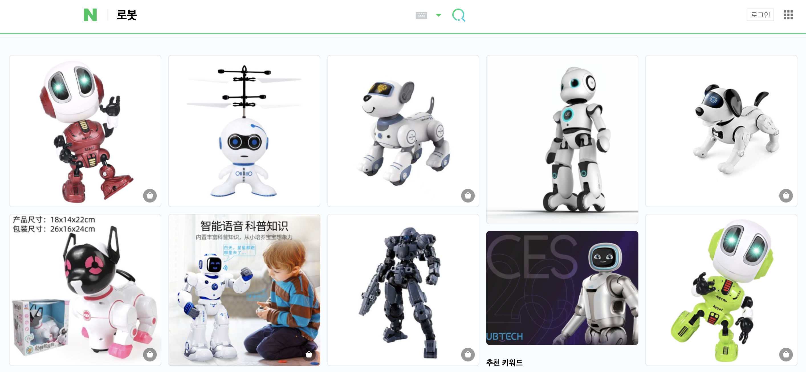
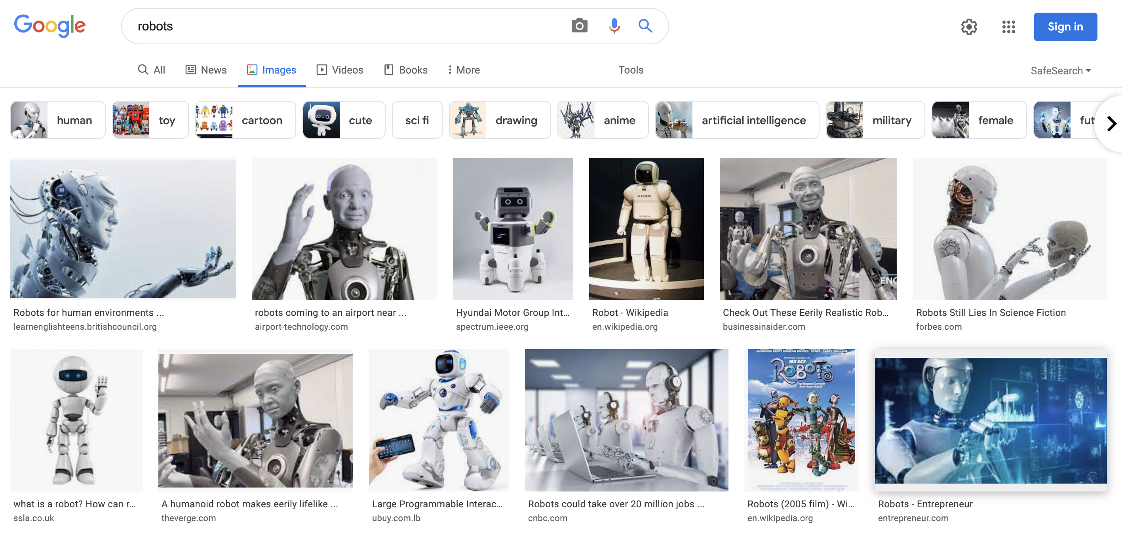
Culture and context
In what contexts have you seen robots?
Not about designing robots for specific cultures, but about designing robots to be sensitive and adaptable to cultural values and practices
Cultural adaption != a new problem
Cultural marketing examples?

Slide 3

How does culture affect people’s attitudes towards robots?
Question(s)
What is culture?
Language, social norms, media
Towards what robots? In what contexts? Appearance?
Factory, healthcare, school, pet, friend
Who are these people?
Age, gender, education, prior experience

Slide 4
Short answer
We can’t make any direct conclusions about any correlations…
Spaniards are more likely than Italians and Germans to find robots more useful and positive
Pigini, Facal, Blasi, & Andrich, 2012
British have a more negative attitude toward robots than Japanese; Mexicans more than Americans
Nomura et al., 2015; Bartneck, Suzuki, Kanda, and Nomura, 2007
Australians are more likely to like and trust robots than Japanese
Haring, Silvera-Tawil, et al., 2014
Japanese perception of robot’s intelligence and safety became more positive after direct interaction with robots than Australian
Haring, Silvera-Tawil, Watanabe, and Velonaki, 2016

Slide 5

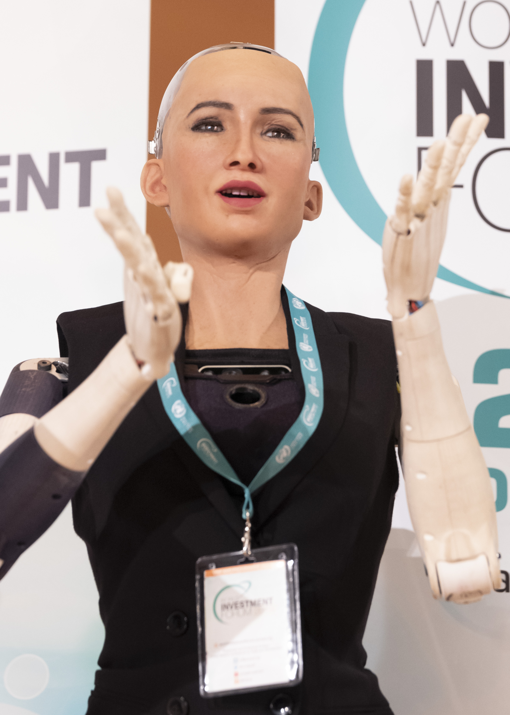
Humanlike-ness
Why do some prefer a humanlike robot and others a machinelike one?
Japanese show higher preference for humanlike robots than Europeans
Haring, Mougenot, Ono, and Watanabe, 2014
Americans feel more comfortable around humanlike robots than Japanese
Bartneck, 2008; Kamide and Arai, 2017
Koreans thought humanlike robots could be part of social life, whereas Americans preferred machinelike robots and viewed them as tools
Lee and Sabanovic, 2014
Is there such a thing as “too humanlike”?
Uncanny Valley!

Slide 6
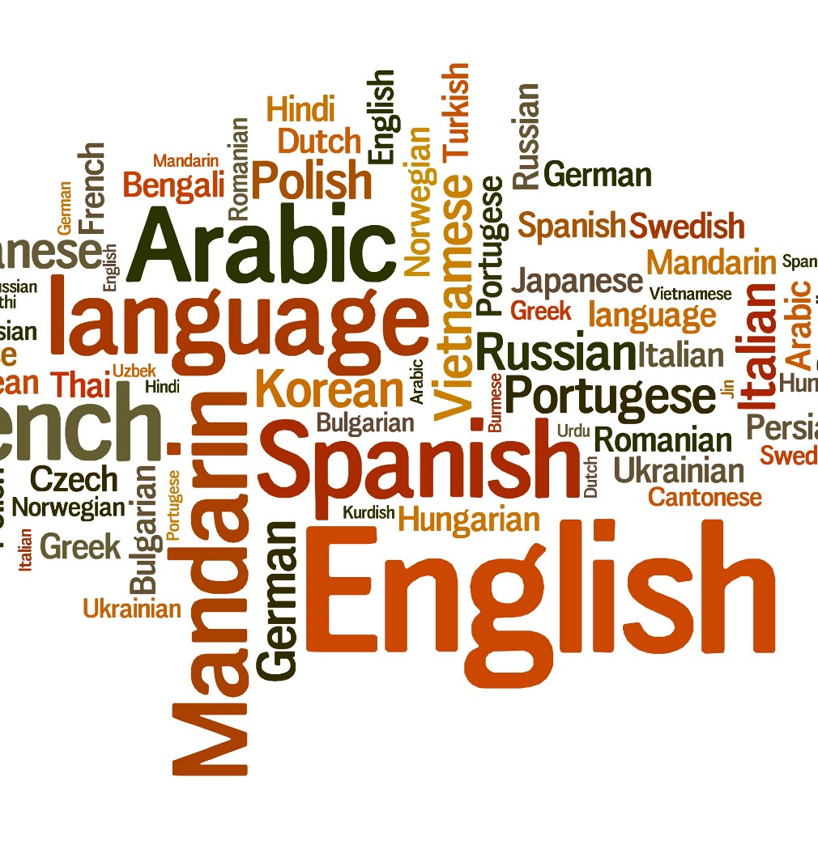
Language
Low-context vs. high-context
”Correct language”
Knowledge, metaphors, organization, fluency
Nonverbal
Japanese – bow
Trovato et al. (2013)
Arab vs. German – distance
Eresha, Häring, Endrass, André, and Obaid (2013)
Dialect
MSA vs. Lebanese dialect
Andrist, S., Ziadee, M., Boukaram, H., Mutlu, B., & Sakr, M. (2015)
Language? Mirroring? Conformity?

Slide 7

Beliefs
Confucian social norms
Bow and use honorifics
Home, museum, hotel, humanlike, female
Animist beliefs
A tree, an animal, a robot has a soul
Soul != human-likeness
Human exceptionalism
Unique among creatures, owner of nature that can be used as a tool
Koreans more than Americans and Turkish, but they don’t necessarily view robots as tools
Lee, Hee & Sabanovic, S.. (2014).

Slide 8
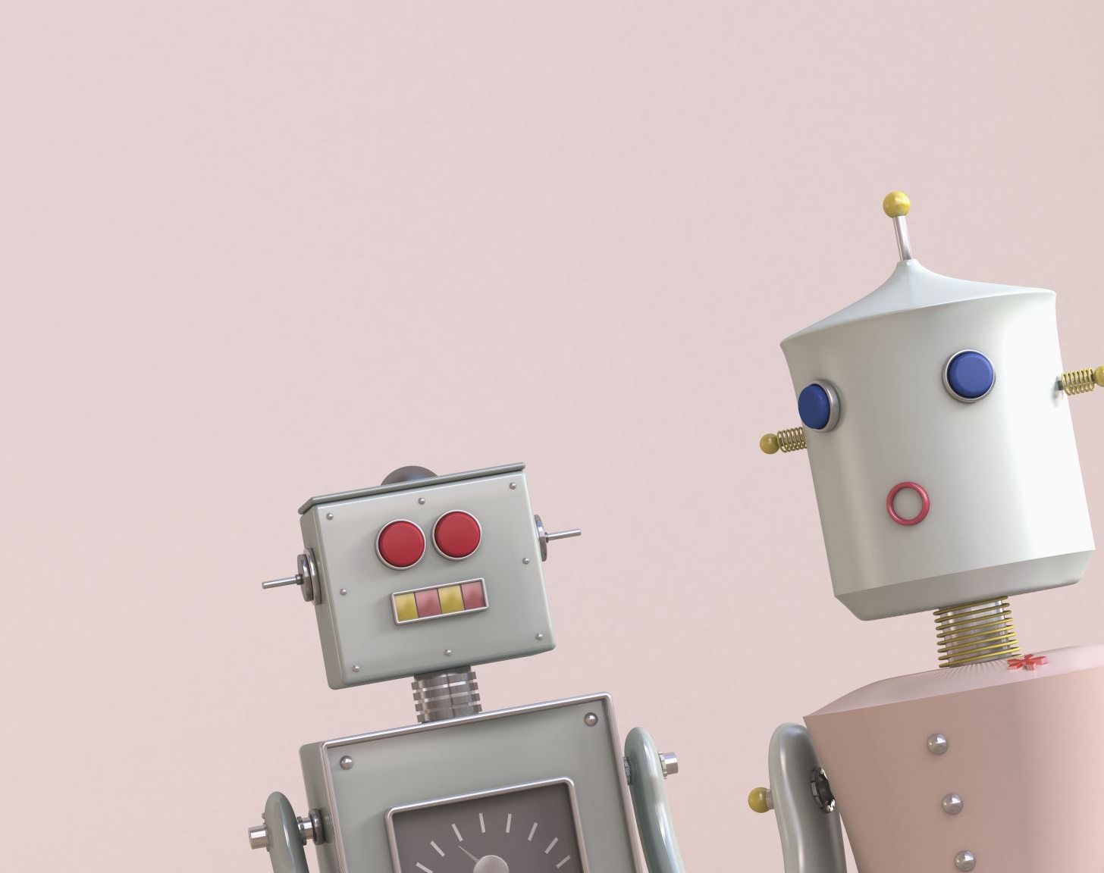
More Questions than Answers
What is the general attitude toward robots that you experienced in your home culture/country?
Should robots be considered tools or “social beings”? Does the context matter?
What do you think of cultural adaptation? Should all cultural beliefs and behaviors be adapted to?
Can robots form their own culture? What might a “robot culture” look like?

Slide 9
References
Andrist, S., Ziadee, M., Boukaram, H., Mutlu, B., & Sakr, M. (2015). Effects of Culture on the Credibility of Robot Speech: A Comparison between English and Arabic. ACM/IEEE International Conference on Human-Robot Interaction, 157–164. https://doi.org/10.1145/2696454.2696464
Haring, K. & Mougenot, C., Ono, F., & Watanabe, K. (2014). Cultural Differences in Perception and Attitude towards Robots. International Journal of Affective Engineering, 13: 149-157. https://doi.org/10.5057/ijae.13.149
Lee, Hee & Sabanovic, S.. (2014). Culturally variable preferences for robot design and use in South Korea, Turkey, and the United States. ACM/IEEE International Conference on Human-Robot Interaction. 17-24. https://doi.org/10.1145/2559636.2559676
Papadopoulos, I. & Koulouglioti, C. (2018), The Influence of Culture on Attitudes Towards Humanoid and Animal-like Robots: An Integrative Review. Journal of Nursing Scholarship, 50: 653-665. https://doi.org/10.1111/jnu.12422
Samani, H., Saadatian, E., Pang, N., Polydorou, D., Fernando, O. N. N., Nakatsu, R., & Koh, J. T. K. V. (2013). Cultural Robotics: The Culture of Robotics and Robotics in Culture. International Journal of Advanced Robotic Systems. https://doi.org/10.5772/57260

